Slide 1

Group 2’s Final Project
Dylan Britain
Gabriel Ceballos
Ruhama Bekele
Ajah Carter

Slide 2
Abstract
We were tasked to create a website which had to include HMTL, CSS, and JavaScript. Our group was able to implement all those languages in a website for a fictional restaurant called Foodstuffz.

Slide 3
Introduction
Our group decided to build a website of a restaurant that implements HTML, CSS, and Javascript. Each of the members contributed to designing the website of the restaurant called Foodstuffz. The group was able to by using the languages mentioned before.

Slide 4
Group 2’s Final Project
Dylan Britain’s Portion
December 2nd, 2022

Slide 5
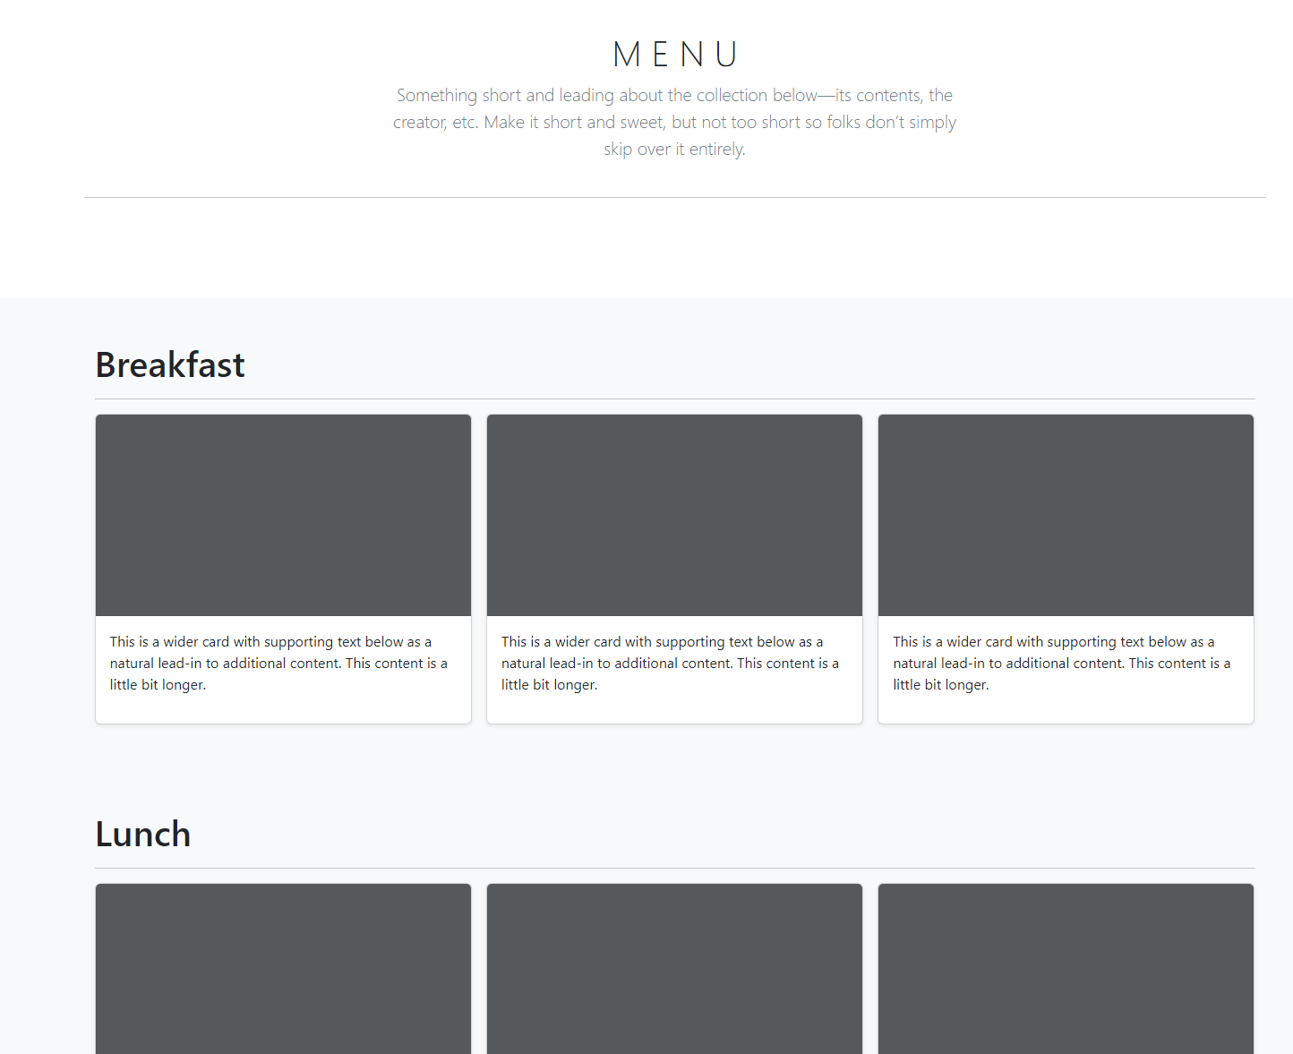
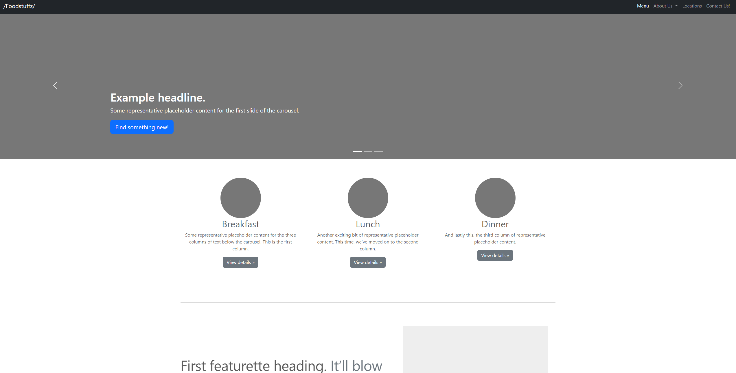
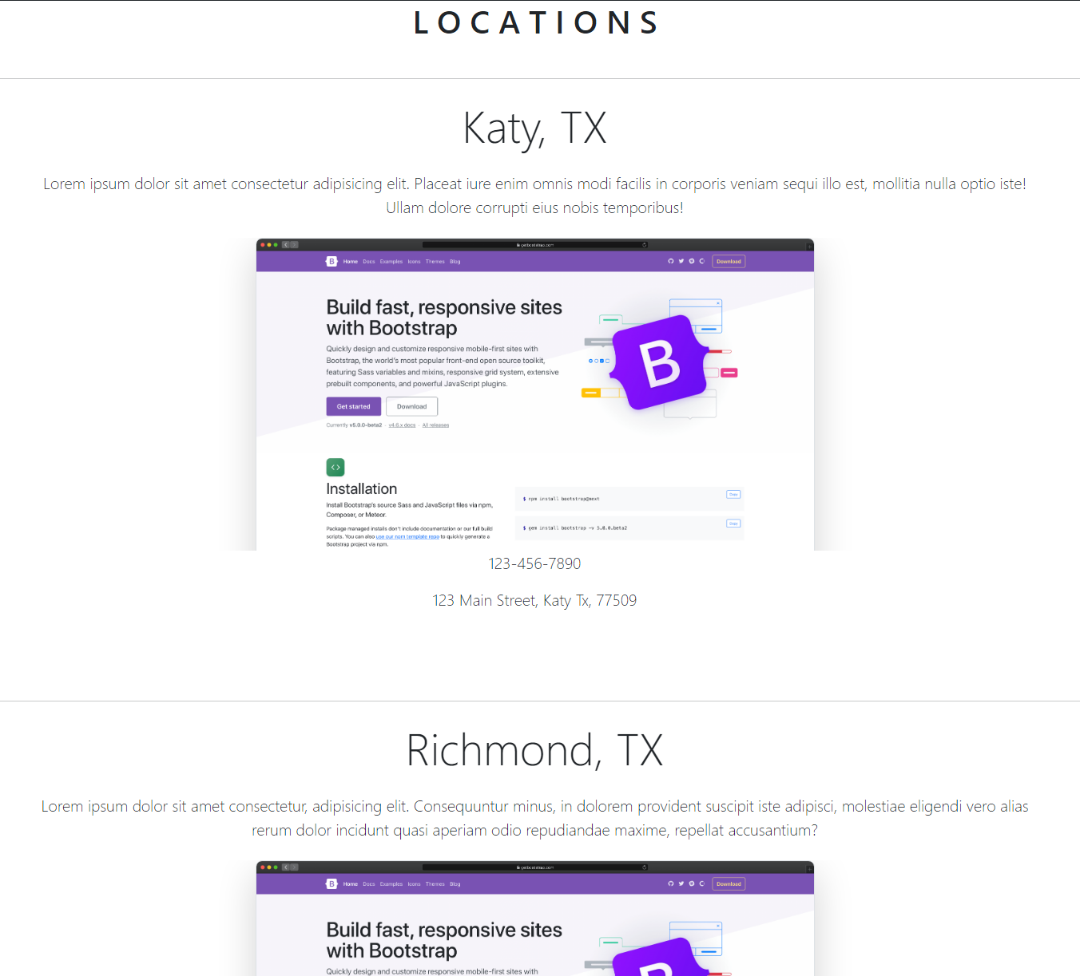
HTML / CSS Templating
By integrating Bootstrap into our project, I was able to create easily customizable and sleek web pages.
After creating the bones of the website, Ajah Carter and Ruhama Bekele will work together to customize the site for our needs.

Slide 6
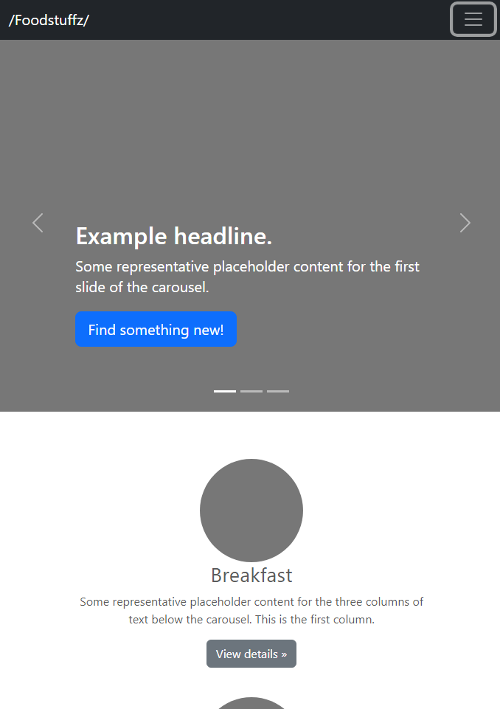
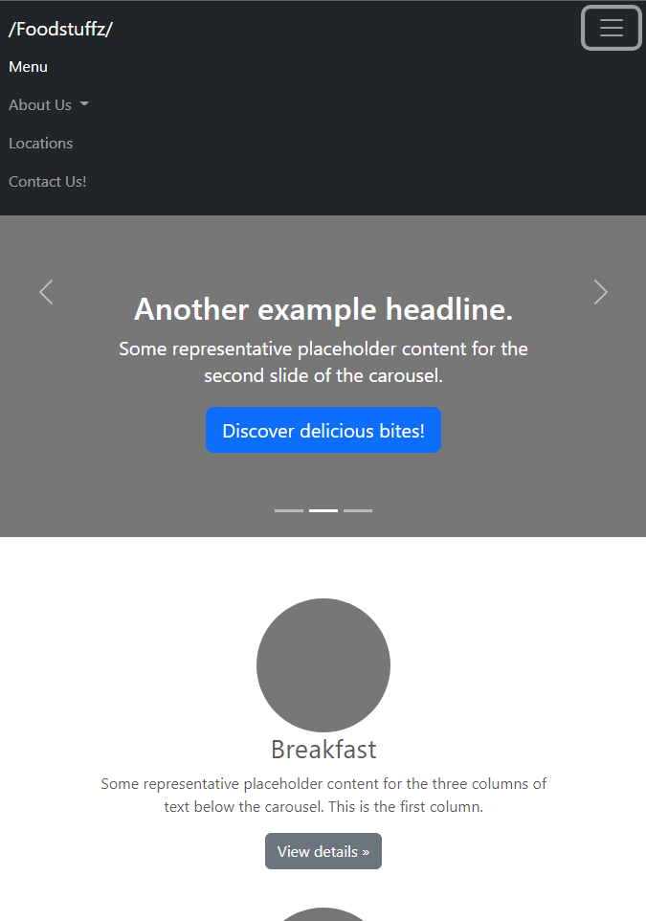
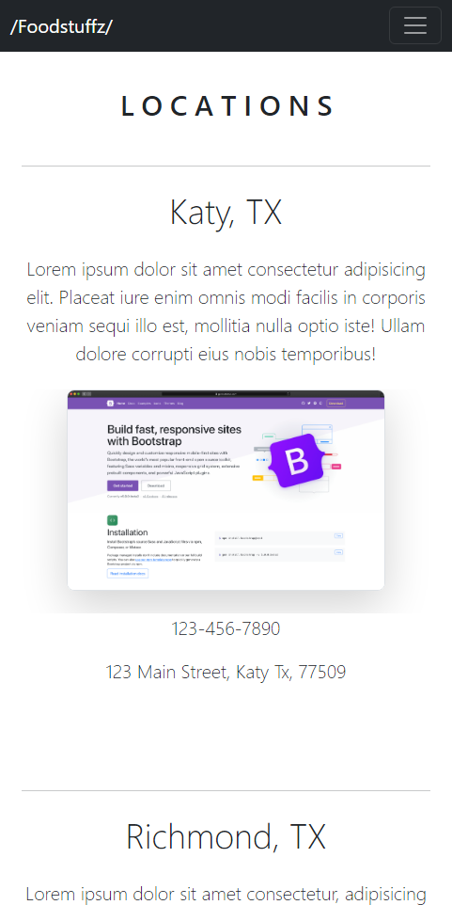
Flexbox Integration
Because of Bootstrap’s integration with Flexbox, our site is instantly reactive to window rescaling and ready for use on multiple devices.
Bootstrap’s Navbar classes allow for collapsible hamburger menus after reaching a certain X-Threshold

Slide 7
In-depth Look at My Work
https://youtu.be/z9T1VITiMSk

Slide 8
Future Work
In the future we would create a database that contains all the food that is available in our website.

Slide 9
Reference
GitHub-
Bootstrap-
Otto, Mark Jacob Thornton. Bootstrap. getbootstrap.com.
“GitHub: Let’s Build From Here.” GitHub, github.com.

